Slide 1

AI LN3
Fady Alnajjar

Slide 2
Search (Problem solving)
Knowledge (represent knowledge)
Uncertainty
Optimization (best way to solve a problem)

Slide 3
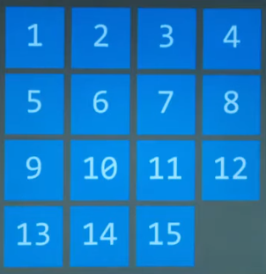
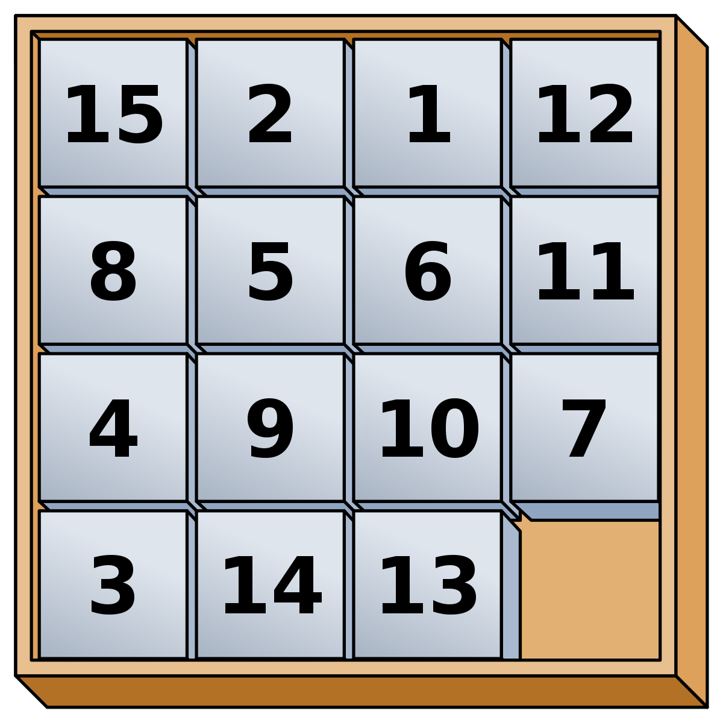
How to re-order the numbers?

Slide 4
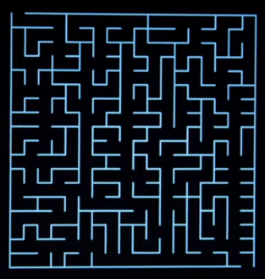
How to move from Start to Goal?

Slide 5
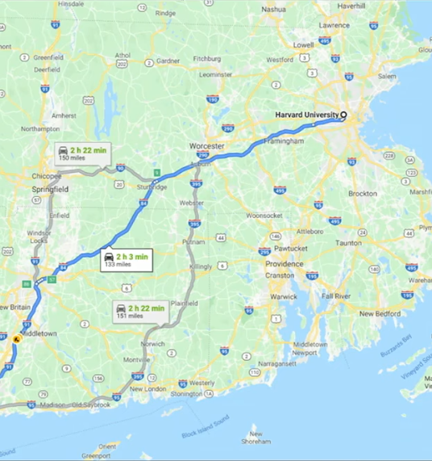
How Google map solve searching problem?

Slide 6
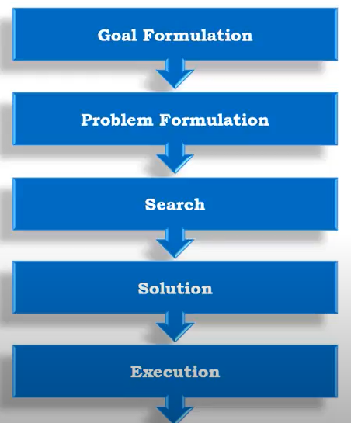
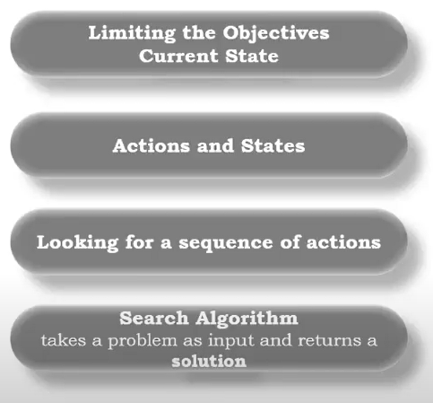

Slide 7






Slide 8
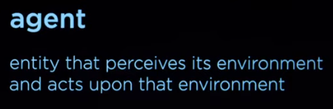
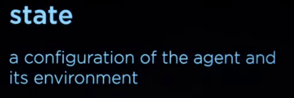
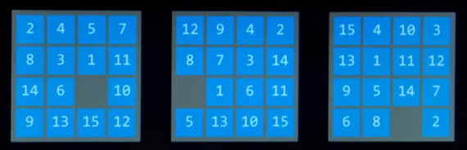
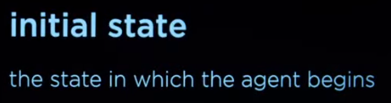
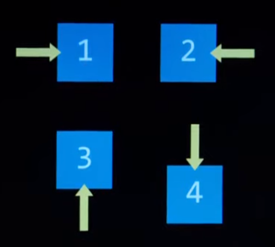
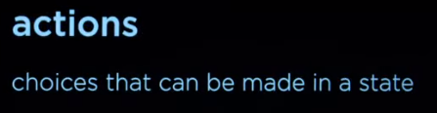
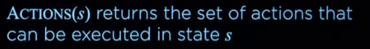
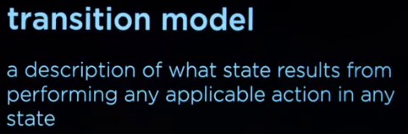
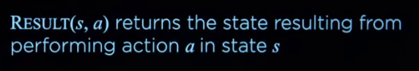

Slide 9
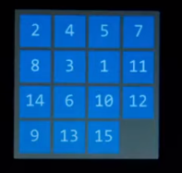
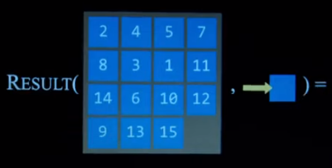
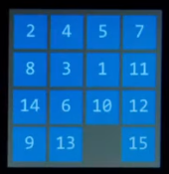
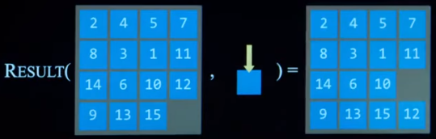
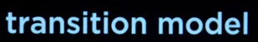
Example
Notes:
Example

Slide 10
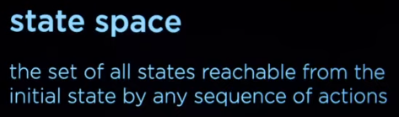
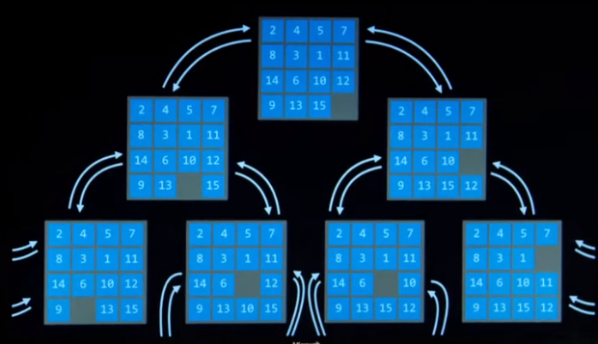

Slide 11
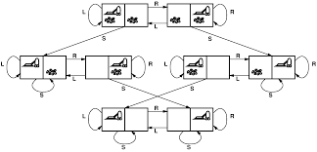

Slide 12
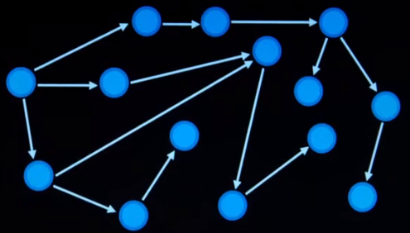
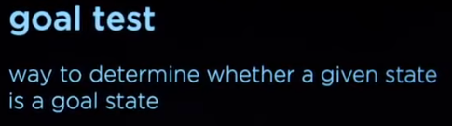

Graph/Maps
Optimization
Notes:
Graph

Slide 13

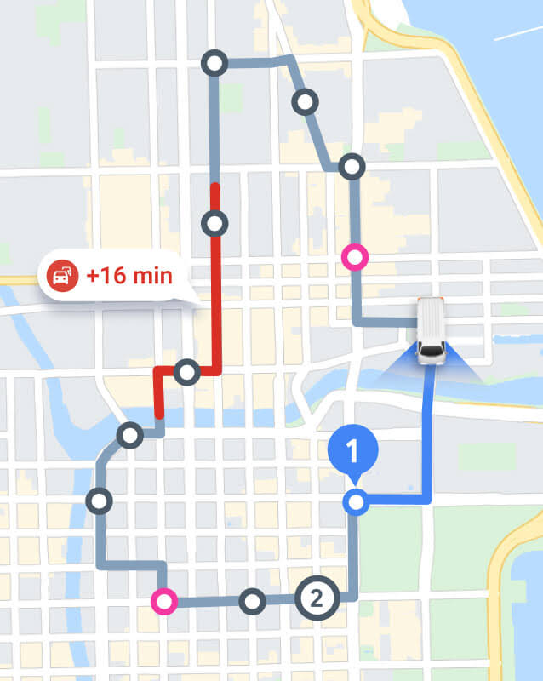
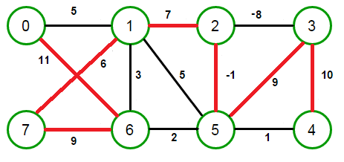
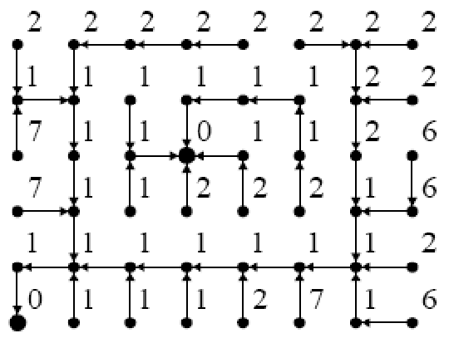
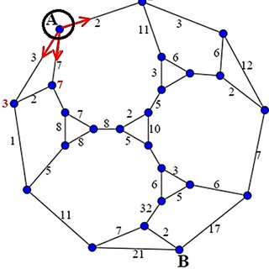

Slide 14

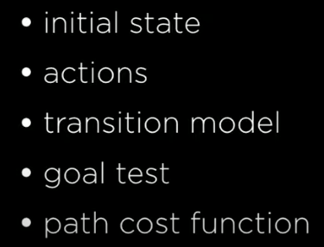
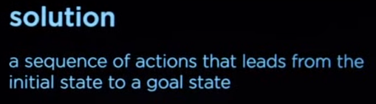
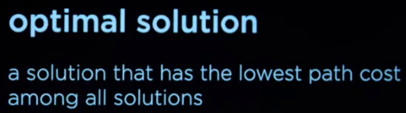

Slide 15

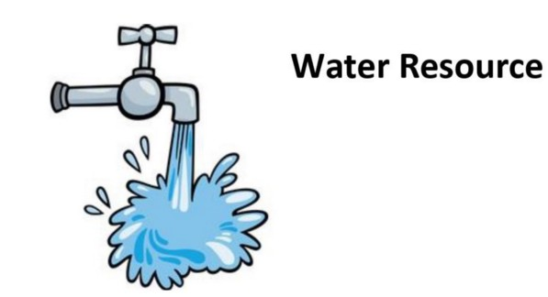
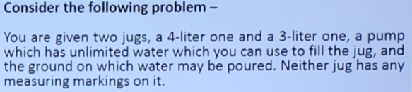
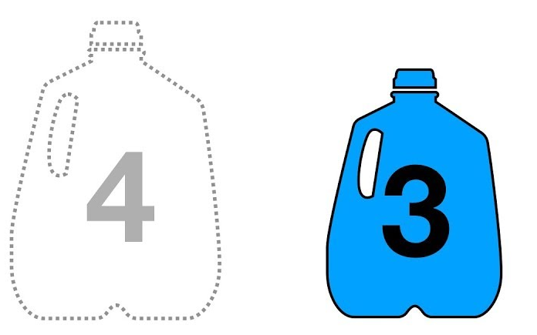
Solving a problem
Notes:
Solving a problem

Slide 16
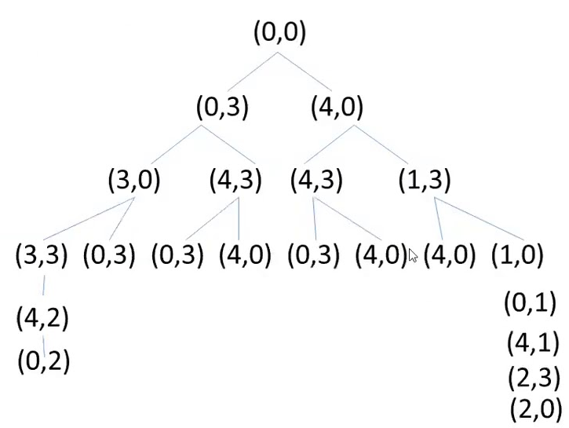
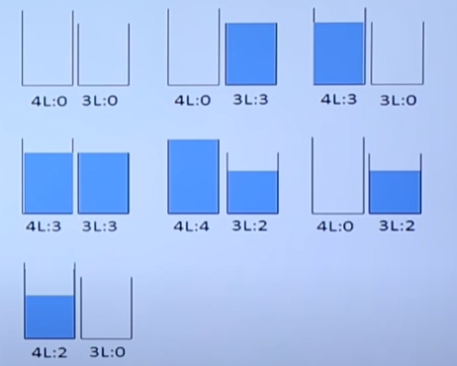

Slide 17
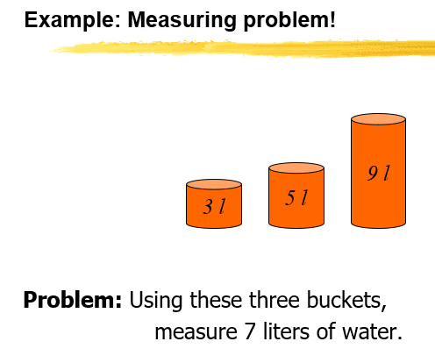

Slide 18
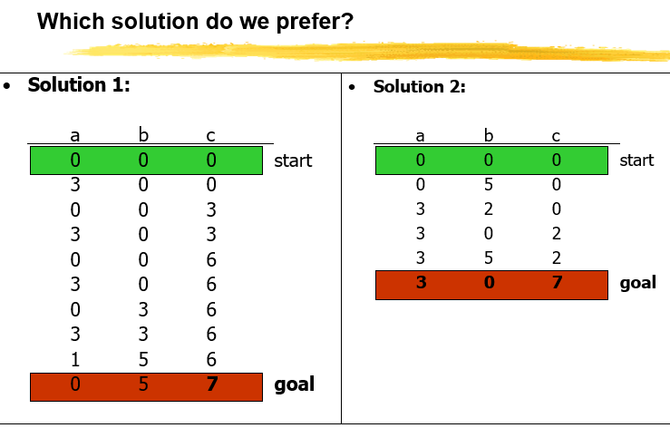

Slide 19
Problem types
Single-state problem: deterministic, accessible
Agent knows everything about world, thus can calculate optimal action sequence to reach goal state.
Multiple-state problem: deterministic, inaccessible
Agent must reason about sequences of actions and states assumed while working towards goal state.
Contingency problem: nondeterministic, inaccessible
Must use sensors during execution
Solution is a tree or policy
Often interleave search and execution
Exploration problem: unknown state space
Discover and learn about environment while taking actions.

Slide 20
Problem types
Single-state problem: deterministic, accessible
Agent knows everything about world (the exact state),
Can calculate optimal action sequence to reach goal state.
E.g., playing chess. Any action will result in an exact state

Slide 21
Problem types
Multiple-state problem: deterministic, inaccessible
Agent does not know the exact state (could be in any of the possible states)
May not have sensor at all
Assume states while working towards goal state.
E.g., walking in a dark room
If you are at the door, going straight will lead you to the kitchen
If you are at the kitchen, turning left leads you to the bedroom
…

Slide 22
Problem types
Contingency problem: nondeterministic, inaccessible
Must use sensors during execution
Solution is a tree
Often interleave search and execution
E.g., a new skater in an arena
Sliding problem.
Many skaters around
Notes:
First survive as long as possible

Slide 23
Problem types
Exploration problem: unknown state space
Discover and learn about environment while taking actions.
E.g., Maze

Slide 24
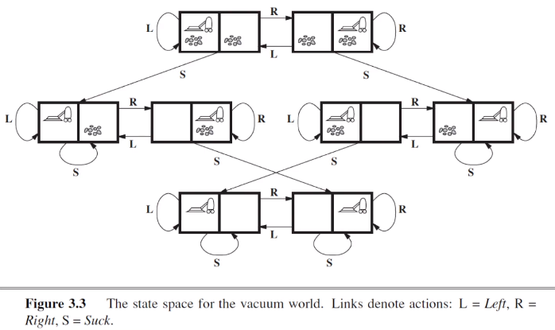
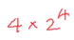
Number of rooms * (number of possible actions) power of number of rooms
Notes:
Number of rooms * number of possible actions

Slide 26
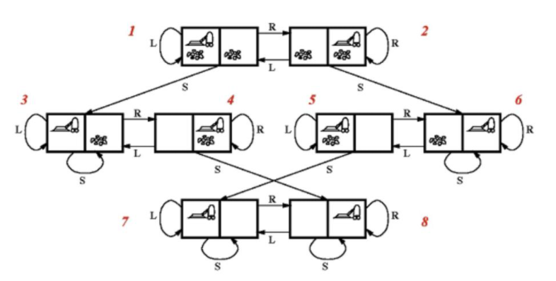
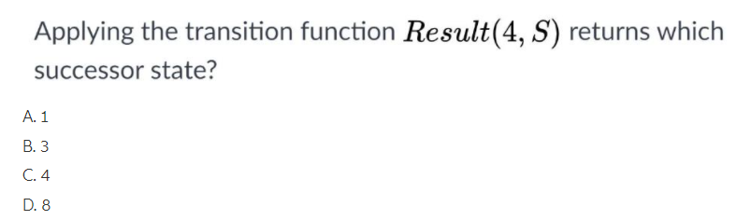
Question:

Slide 27
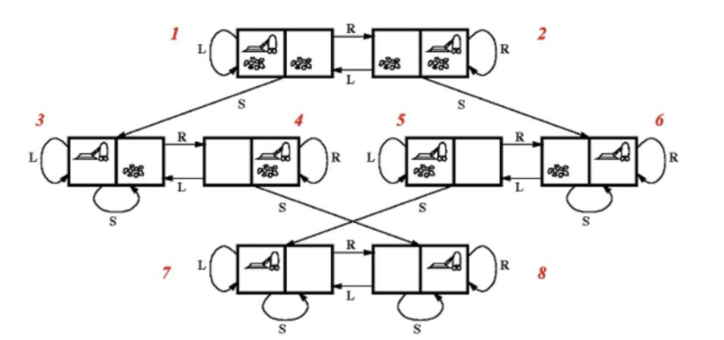
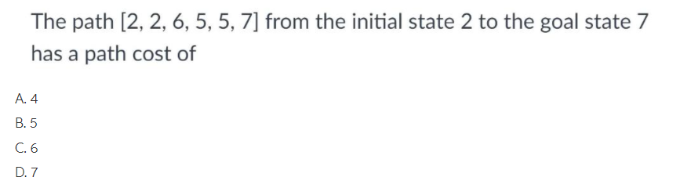
Question:

Slide 28
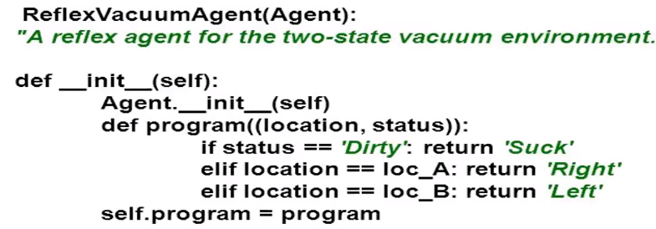
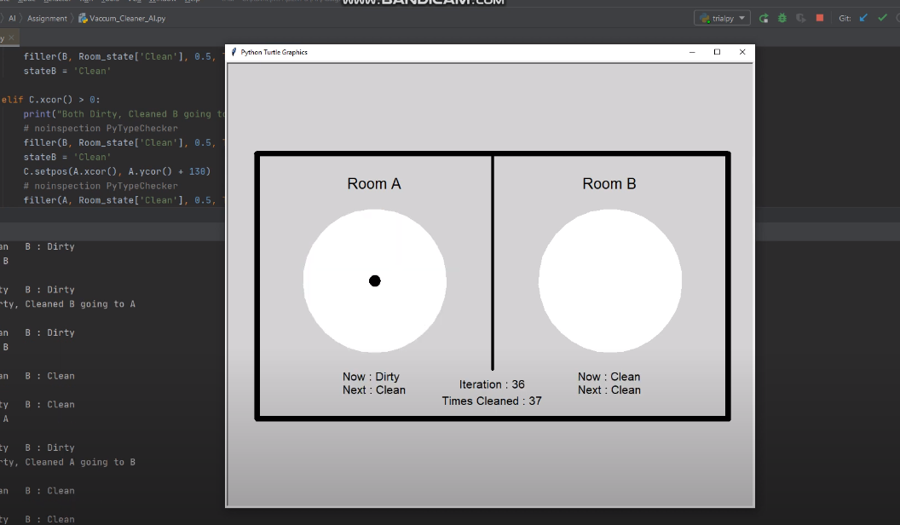
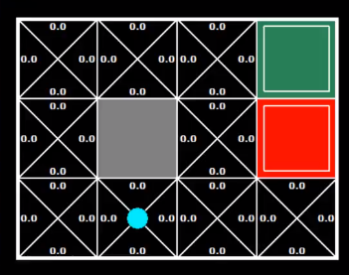
https://www.youtube.com/watch?v=jwgwv7jG8-s
https://www.youtube.com/watch?v=KW3WULDz34g
Notes:
More complicated..

Slide 29
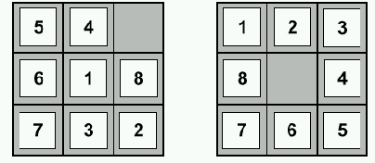
Example: 8-puzzle
start state
goal state
State:
Operators:
Goal test:
Path cost:

Slide 30
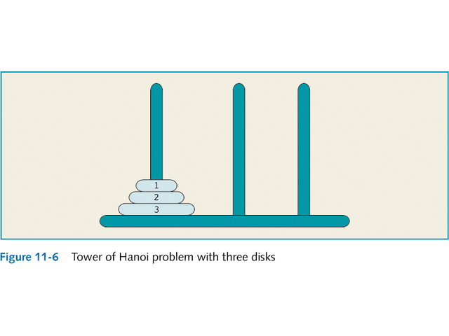
Complexity: Tower of Hanoi

Slide 31

Complexity: Tower of Hanoi

Slide 32




Slide 33


Are we going to find the solution?
Notes:
Are we going to find the solution?

Slide 34




Infinite loop..
Notes:
Infinite loop..

Slide 35

What is the Structure to ADD or Remove from Frontiers?

Slide 36







Slide 37





Slide 38
Finding solutions? Optimal Solutions?
Notes:
Finding solutions? Optimal Solutions?

Slide 39





Not always optimal…
optimal…
Notes:
Not always optimal…

Slide 40


More explorations, and more Memory.
https://www.pythonsandbox.com/code/pythonsandbox_u7210_noklmSiQCyijkAVyN4ZiucGO_v1.py
https://raw.githubusercontent.com/tonypdavis/Depth-First-Search--DFS-/main/DFSv2.py
Notes:
More explorations, and more Memory.

Slide 41

[01356472]
Notes:
[01356472]

Slide 42

[01356472]
Notes:
[01356472]

Slide 43

Solve with DFS
Notes:
Solve with DFS

Slide 44
[01234756]
Notes:
[01234756]

Slide 45

Solve with BFS

Slide 46


Depth limited search

Slide 47

uninformed cost search strategy

Slide 48
Uniform Cost Search
S
6
1
5
9
6
A
3
B
1
C
D
2
2
2
E
9
5
7
2
7
G1
G3
F
8
G2
Notes:
https://www.youtube.com/watch?v=dRMvK76xQJI

Slide 49



https://www.cs.usfca.edu/~galles/visualization/DFS.html

Slide 50




Slide 51










https://workshape.github.io/visual-graph-algorithms/

Slide 52


BFS (Que.)
DFS (Stack)
Notes:
BFS

Slide 53



Searching the entire Maze
Shall I move Right or Left?
How Human solve it? Which option closer to the Goal?
Can it be more Intelligent?
Notes:
Can it be more Intelligent?

Slide 54

Bidirectional Search

Slide 55


Slide 56
Depth-first search
Advantages Of DFS: 1. The memory requirement is Linear. 2. Less time and space complexity rather than BFS. 3. The solution can be found out without much more search.
The disadvantage of DFS: 1. Not Guaranteed that it will give you a solution (limited). 2. Cut-off depth is smaller so time complexity is more. 3. Determination of depth until the search has proceeded.
Breadth-first search
Advantages of BFS:
1. The solution will definitely found out by BFS If there is some solution. 2. BFS will never get trapped in a blind alley, which means unwanted nodes. 3. If there is more than one solution then it will find a solution with minimal steps.
Disadvantages Of BFS: 1. Memory Constraints As it stores all the nodes of the present level to go for the next level. 2. If a solution is far away then it consumes time.
Uniform Cost Search
Advantages
It helps to find the path with the lowest cumulative cost inside a weighted graph having a different cost associated with each of its edge from the root node to the destination node.
It is considered to be an optimal solution since, at each state, the least path is considered to be followed.
Disadvantage
The open list is required to be kept sorted as priorities in priority queue needs to be maintained.
The storage required is exponentially large.

Slide 57




Slide 58




Going to D is better than C
Notes:
Going to D is better than C

Slide 59





Slide 60



Slide 61



Does it always find the optimal solutions? (not always, how to improve it?)
Notes:
Does it always find the optimal solutions?

Slide 62


Slide 63


Slide 64


Slide 65


Slide 66

How far I am from the goal, and far I must travel to the current point?
Notes:
How far I am from the goal, and far I have to travel to the current point?

Slide 67




Going to 19?
Going to 21?
Notes:
Going to 19?

Slide 68


Slide 69

5
6
7
5
3
4
0
0
6
0
0
Notes:
5

Slide 70

5
6
7
5
3
4
0
0
6
0
0
Notes:
5

Slide 71

Adversarial search is search when there is an "enemy" or "opponent" changing the state of the problem every step in a direction you do not want. Examples: Chess. You change state, but then you don't control the next state. Opponent will change the next state in a way: unpredictable

Slide 72




Where to put X?
Notes:
Where to put X?

Slide 73



Slide 74


Possible final situations
Notes:
Possible situations

Slide 75


Slide 76


Whose turn it is now
Notes:
Whose turn it is now

Slide 77



Slide 78



Slide 79





Slide 80


Easy – Mid – Hard: How Deep you want the algorithm to search in the tree.
Notes:
Easy – Mid – Hard: How Deep you want the algorithm to search in the tree.

Slide 81


Abstract Version
Notes:
Abstract Version

Slide 82

Abstract Version
AI Adversarial search: https://www.tutorialandexample.com/adversarial-search-in-artificial-intelligence
https://www.geeksforgeeks.org/minimax-algorithm-in-game-theory-set-3-tic-tac-toe-ai-finding-optimal-move/
Notes:
Abstract Version

